Slide 1
DEPARTMENT OF PHYSICS
SRM INSTITUTE OF SCIENCE AND TECHNOLOGY
18PYB103J –Semiconductor Physics
Lecture-10
SOLVING PROBLEMS
18PYB103J Module-I Lecture-10

Slide 2
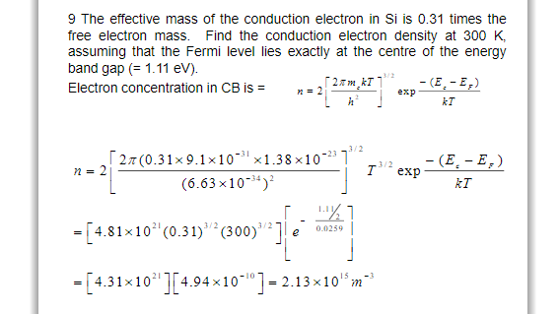
1.
18PYB103J Module-I Lecture-10

Slide 3
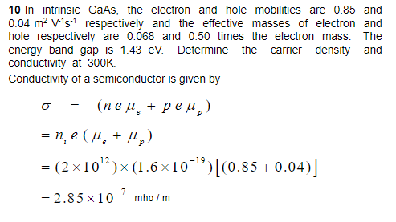
2.
18PYB103J Module-I Lecture-10

